Slide 1
LGB
OPERATIONS TECHNOLOGY
Oct 2026
Monthly Project Progress
Software & IOT
Annur• PGR • K-palayam • FPD
LGB | Operations Technology

Slide 2
YEARLY PLAN - PROJECTS 2026
2026 Projects Plan
S.No | Project Name | Project Description | Status | Plant | Start Month | End Month
Digitization - Existing Projects
1 | Furnace | A furnace monitoring and inspection system that ensures process quality, safety compliance, and operational parameter checks during heat treatment operations. | Completed & Running | Pongalur, Vaiyampalaym,Chennai,Annur(In progress) | SEP 25 | FEB 26
2 | Operator Buddy | A digital assistant system that guides shop-floor operators through tasks, checks, and data entry to ensure correct and efficient production activities. | Completed & Running | Kpalaym,Pongalur,Ppalayam,Annur | APR 25 | JAN 26
3 | Press Digitilization | It enables tracking, compliance, and lifecycle management of equipment and related activities across the shop floor. | Completed & Running | PONGALUR, ANNUR & CHENNAI | JUNE 25 | JAN 26
4 | PRISM | A Manufacturing Execution System that integrates and reports real-time production data from shop floor operations for monitoring and control. | Completed & Running | Kpalaym,Pongalur, Ppalayam, Annur,Vaiyampalayam,chennai | APR 25 | JAN 26
5 | AI Production | An AI-driven furnace analytics system that monitors utilization, charge parameters, cycle time, and setpoint deviations to evaluate process performance and quality in real time. It provides RED/GREEN insights, target attainment analysis, and operational dashboards to optimize furnace efficiency and compliance. | Initated and Testing In progress | COE (Testing) | JAN 26 | JUNE 26
6 | SFQA(Shopfloor Quality Assist) | A system or process that supports real-time quality inspection and assurance activities directly on the manufacturing shop floor. | Completed & Running | Kpalayam,Ppalayam,pongalur | OCT 24 | APR 25
7 | AssetHub | A centralized asset management platform that integrates modules such as metallurgy, instrument calibration, and operational checklists to manage manufacturing assets and quality processes. | Completed & Running | Pongalur,ppalayam,kpalayam | JUNE 25 | JAN 26
8 | OTNEXUS | OTNexus is a centralized web-based industrial utility platform that provides essential engineering, production, quality, IT, and business tools. | Inprogress | Common for all plant | JUNE 26 | JULY 26
9 | Servo 8T press machine | SFQA is an automated quality validation and traceability system integrated with the 8T Press Servo Machine and PLC to prevent incorrect assembly and ensure product quality. | Completed | P.Palayam | JUNE 26 | JULY 26
10 | Kit Packing | The Kit Packing Application prevents incorrect kit dispatch by ensuring the right components are packed for the right order. It enables complete reverse traceability of every kit, ensuring transparency and accountability throughout the dispatch process. | Inprogress | Ganapathy | Sept 26 | Nov 26
LGB l Operations Technology

Slide 3
YEARLY PLAN - PROJECTS 2026
2026 Projects Plan
S.No | Project Name | Project Description | Status | Plant | Start Month | End Month
Digitization - Existing Projects
11 | FPD Press Phase 2 | It enables tracking, compliance, and lifecycle management of equipment and related activities across the shop floor at banglore jalna pantnagar lsp FPD2 | Inprogress | All FPD Plants | Oct 2026 | Dec 2026
12 | SMD | Air bag stitch analysis | Inprogress | SMD | Sept 2026 | Oct 2026
LGB l Operations Technology

Slide 4
01
Furnace

Slide 5
Furnace - PHASE 1 ( Oct PLAN vs ACTUAL )
Furnace - PHASE 1
Task ID | Task Description | Team | Planned |  | Actual |  | Status | Responsibility | Remarks
 |  |  | Start Date | End Date | Start Date | End Date
1 | CP data in single report should be in float type. | Software | 08-Oct-2026 | 10-Oct-2026 | 08-Oct-2026 | 10-Oct-2026 | Close | Durga,vishnunirmalan
2 | Process Integration from pre heat to tempering - report | Software | 01-Oct-2026 | 04-Oct-2026 | 01-Oct-2026 | 04-Oct-2026 | Close | Durga,vishnunirmalan
3 | Excel mapping to PRISM, Red Charge & Green Charge based on set time and set point. | Software | 21-Oct-2026 | 24-Oct-2026 |  |  |  | Durga,vishnunirmalan
4 | Charge comparison report for same part number across furnaces and different part numbers in same furnace. | Software | 20-Oct-2026 | 23-Oct-2026 |  |  |  | Durga,vishnunirmalan
5 | Furnace utilization comparison dashboard/report. | Software | 22-Oct-2026 | 23-Oct-2026 |  |  |  | Durga,vishnunirmalan
6 | Energy dummy data loading for different charges and part numbers. | Software | 24-Oct-2026 | 27-Oct-2026 |  |  |  | Durga,vishnunirmalan
7 | Single chart report as main dashboard. | Software | 13-Oct-2026 | 14-Oct-2026 |  |  |  | Durga,vishnunirmalan
8 | Auto History Card printing based on work order, part number and telemetry data. | Software | 10-Oct-2026 | 15-Oct-2026 |  |  |  | Durga,vishnunirmalan
9 | Instrument calibration due monitoring and API integration to PRISM. | Software | 20-Oct-2026 | 27-Oct-2026 |  |  |  | Durga,vishnunirmalan
LGB l Operations Technology

Slide 6
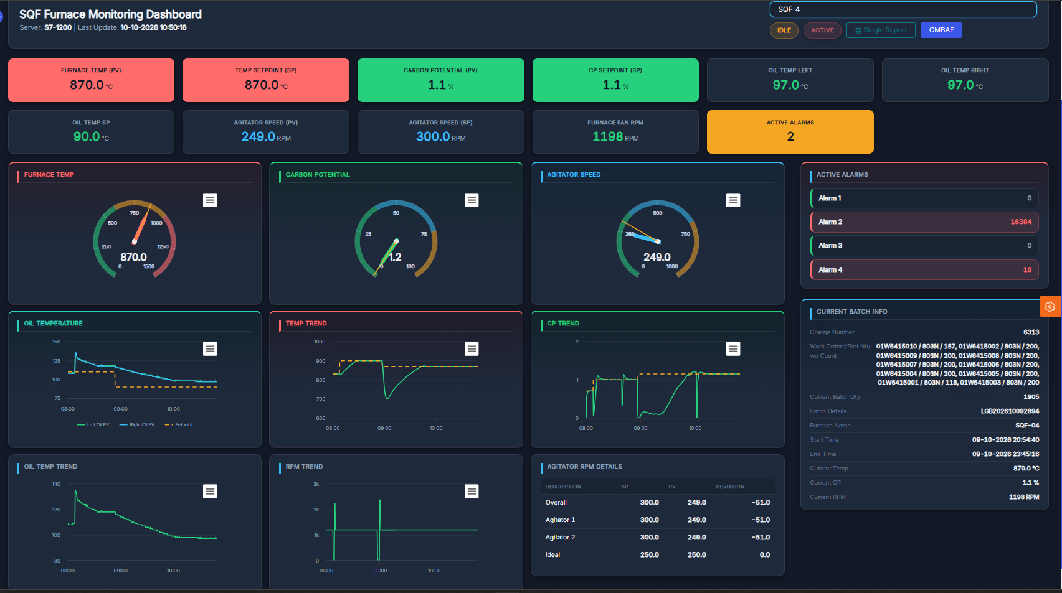
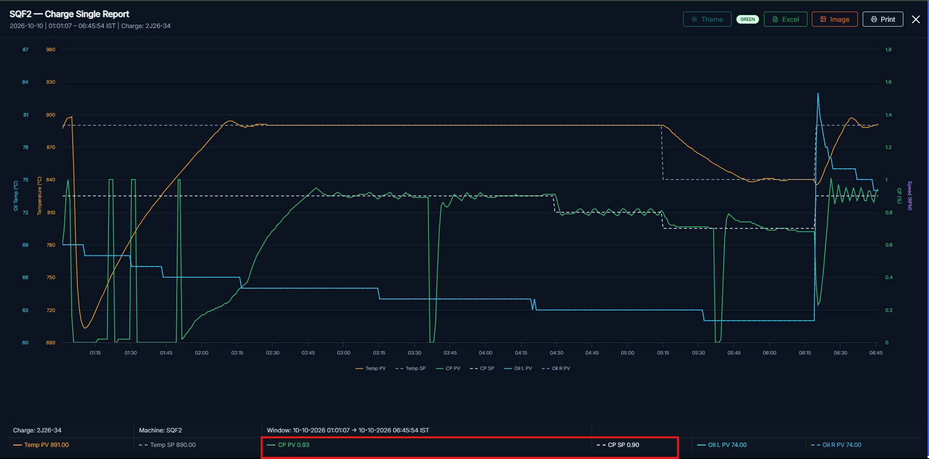
Furnace DASHBOARD
LGB l Operations Technology

Slide 7
02
Operator Buddy

Slide 8
Operator Buddy - PHASE 2 OCTOMBER PLANNED TASK
Operator Buddy - Phase 2
Task ID | Task Description | Team | Planned |  | Actual |  | Status | Responsibility | Remarks
 |  |  | Start Date | End Date | Start Date | End Date
Development & Deployement
1 | First stage entry in operator buddy (SAP not integrated - POC) | Software | 3-Oct-26 | 7-Oct-26 | 3-Oct-26 | 7-Oct-26 | Close | Durga
2 | Assembly stage entry development | Software | 10-Oct-26 | 16-Oct-26 |  |  | Open | Hariharasudhan | Not started
3 | Plan Vs Actual in WIP screen | Software | 01-Oct-26 | 05-Oct-26 | 08-Oct-26 | 12-Oct-26 | Open | Durga
4 | Process Integration from pre heat to tempering | Software | 01-Oct-2026 | 04-Oct-2026 | 01-Oct-2026 | 04-Oct-2026 | Close | Durga,vishnunirmalan
LGB l Operations Technology

Slide 9
03
Press Digitilization

Slide 10
Press Digitilization - PHASE 2 OCTOMBER PLANNED TASK
Press Digitilization
Task ID | Task Description | Team | Planned |  | Actual |  | Status | Responsibility | Remarks
 |  |  | Start Date | End Date | Start Date | End Date
Development & Deployement
1 | KG Conversion - Maestro | Software | 3-Oct-26 | 7-Oct-26 | 3-Oct-26 | 12-Oct-26 | Open | Vishnunirmalan | Not started
2 | Work order completion alarm - Maestro | Software | 10-Oct-26 | 16-Oct-26 |  |  | Open | Hariharasudhan | Not started
3 | Maestro Stroke count into Prism Dashboard | Software | 01-Oct-26 | 05-Oct-26 | 01-Oct-26 | 05-Oct-26 | Close | Hariharasudhan
4 | Maestro Downtime count into Prism Dashboard | Software | 01-Oct-26 | 05-Oct-26 | 01-Oct-26 | 05-Oct-26 | Open | Hariharasudhan
7 | Machine Reports | Software | 20-Oct-2026 | 24-Oct-2026 |  |  | Open | Hariharasudhan
8 | 15 FPD Digitilization (LSP,FPD 2, Jalna,Pantnagar,Nagpur,Banglore) | IoT | 06-Oct-26 | 30-Oct-26 |  |  | Open | Vishnunirmalan | LAN Survey
LGB l Operations Technology

Slide 11
MAESTRO REPLICATION IN PRISM
Navigation module implementation checklist and schedule
Navbar Category | Checklist / Menu Item | Plan Start Date | Plan End Date | Actual Start Date | Actual End Date | Status | Remarks
Dashboard | ☑ Daily Dashboard |  |  |  |  | Completed
Dashboard | ☑ Report Dashboard |  |  |  |  | Completed
Dashboard | ☑ Machine Dashboard |  |  |  |  | Completed
Production | ☑ Dashboard |  |  |  |  | Completed
Production | ☑ Part Management |  |  |  |  | Completed
Production | ☑ Work Order |  |  |  |  | Completed
Production | ☑ Work Order Schedule |  |  |  |  | Completed
Production | ☑ Production Schedule |  |  |  |  | Completed
Production | ☑ Manual Entries |  |  |  |  | Completed
Quality Check Sheets | ☐ Quality Check Sheets |  |  |  |  | Pending | Not Required
Maintenance | ☐ Maintenance |  |  |  |  | Pending | In Asset Hub
Masters | ☑ Tool Master |  |  |  |  | Completed
Masters | ☐ Quality Master |  |  |  |  | Pending | Not Required
Masters | ☐ Maintenance Master |  |  |  |  | Pending | Not Required
Settings | ☐ Settings |  |  |  |  | Pending | Shift setting available
Report | ☑ Production Reports |  |  |  |  | Completed
Report | ☑ DownTime Reports |  |  |  |  | Completed
Report | ☐ Quality Checksheet Reports |  |  |  |  | Pending | Not Required
Report | ☐ Organisation Reports |  |  |  |  | Pending | Not Required
Report | ☐ Machine Reports | 20-Oct-2026 | 24-Oct-2026 |  |  | Pending

Slide 12
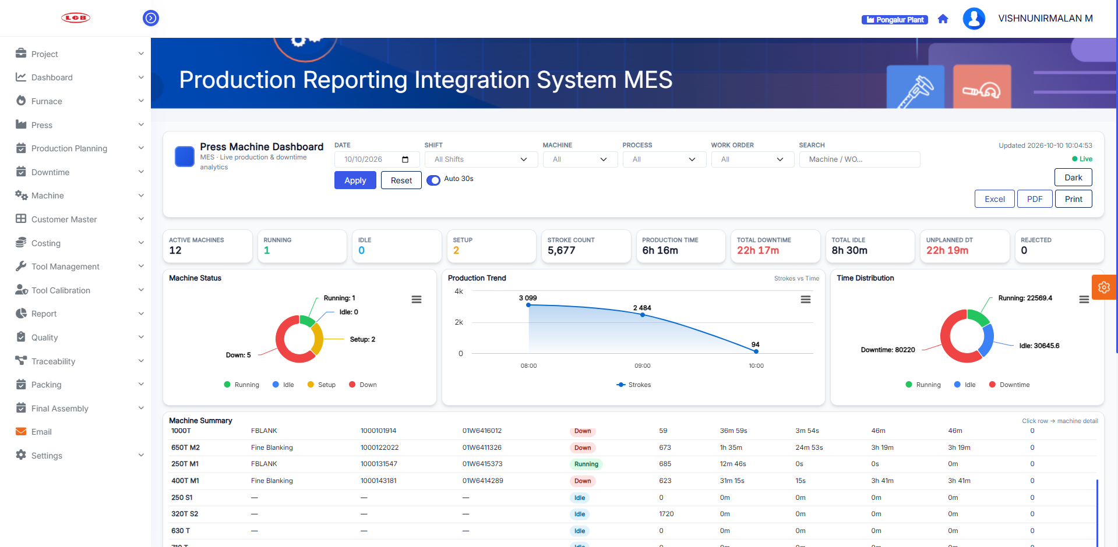
PRISM PRESS DASHBOARD
Press Dashboard In PRISM
LGB l Operations Technology

Slide 13
04
PRISM

Slide 14
PRISM - PHASE 2 OCTOMBER PLANNED TASK
PRISM
Task ID | Task Description | Team | Planned |  | Actual |  | Status | Responsibility | Remarks
 |  |  | Start Date | End Date | Start Date | End Date
Development & Deployement
1 | Machine Monitering | Software | 06-Oct-26 | 17-Oct-26 | 6-Oct-26 |  | In Progress | Durga | Under development
2 | All Reports Optimization | Software | 20-Oct-26 | 24-Oct-26 |  |  | Open | Durga | Not Started
LGB l Operations Technology

Slide 15
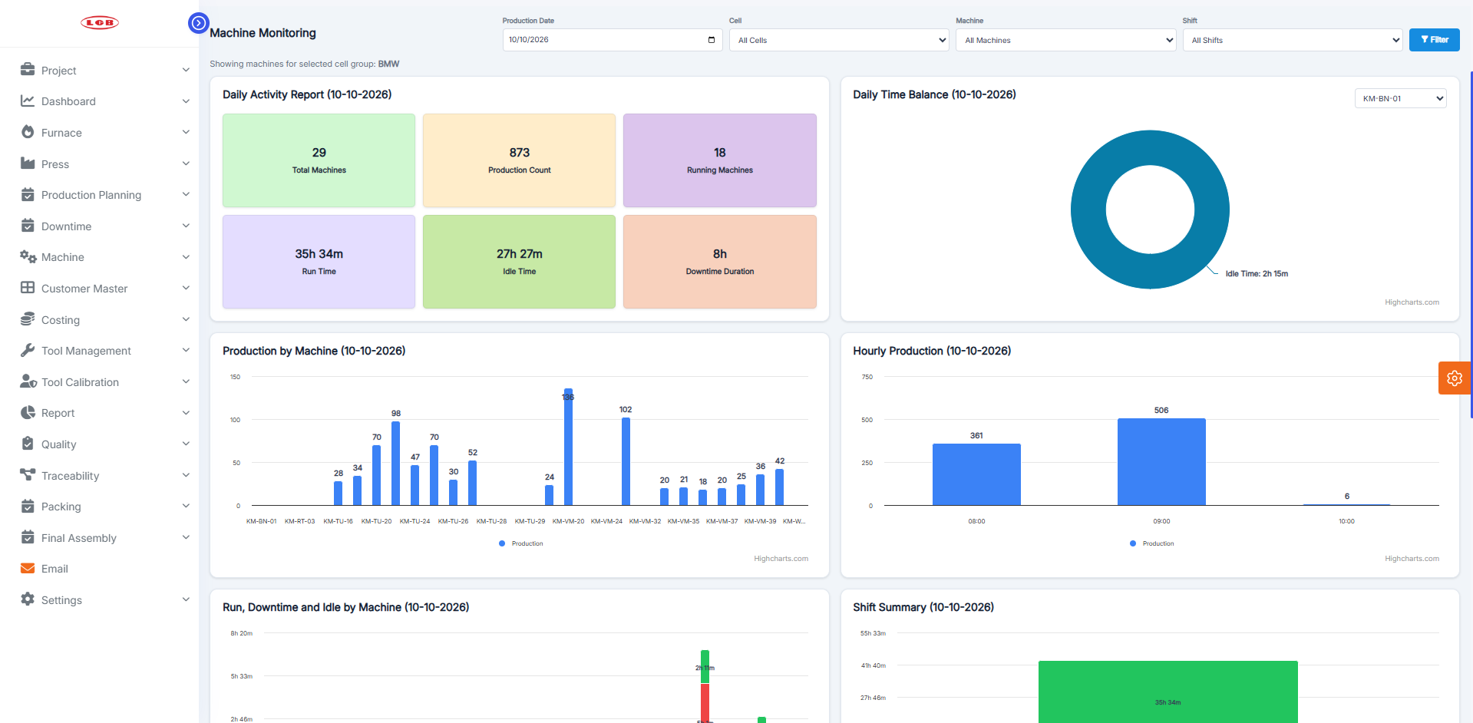
PRISM CNC DASHBOARD
CNC Dashboard In PRISM
LGB l Operations Technology

Slide 16
05
Kit Packing

Slide 17
KIT PACKING PROJECT – WBS / PROJECT SCHEDULE
STO → Feasibility → Packing → Parent Label → SAP Production Entry → ATD → Invoice → Dispatch
S No. | Task Description | Duration (Days) | Planned Start | Planned Finish | Actual Start | Actual Finish | Remarks | Status | % Completion
1.00 | INITIATE & REQUIREMENT CONFIRMATION
1.01 | Review KIT packing business requirement |  | 25.08.2026 | 30.08.2026 | 25.08.2026 | 30.08.2026 |  | Completed | 100%
1.02 | Confirm end-to-end process with requester |  | 02.09.2026 | 10.09.2026 | 02.09.2026 | 10.09.2026 |  | Completed | 100%
1.03 | Confirm project scope, deliverables and priorities |  | 10.09.2026 | 16.09.2026 | 10.09.2026 | 16.09.2026 |  | Completed | 100%
1.04 | Raise BAPI requirements / requisition to SAP team |  | 16.09.2026 | 23.09.2026 | 16.09.2026 | 23.09.2026 |  | Completed | 100%
2.00 | SAP INTEGRATION
2.01 | STO Plan – BAPI integration and SAP data fetching |  | 24.09.2026 | 25.09.2026 | 24.09.2026 | 25.09.2026 |  | Completed | 100%
2.02 | Feasibility – BAPI integration and SAP data fetching |  | 29.09.2026 | 30.09.2026 | 29.09.2026 | 30.09.2026 |  | Completed | 100%
2.03 | Production Entry – finalize BAPI with SAP team |  | 12.10.2026 | 15.10.2026 |  |  | Fields to be confirmed with SAP for Production entry after demo | Pending | 0%
2.04 | ATD Location – finalize BAPI/interface with SAP team |  | 12.10.2026 | 15.10.2026 |  |  | Fields to be confirmed with SAP for Production entry after demo | Pending | 0%
2.05 | Invoicing – finalize BAPI/interface with SAP team |  | 12.10.2026 | 15.10.2026 |  |  | Fields to be confirmed with SAP for Production entry after demo | Pending | 0%
3.00 | UI DEVELOPMENT & PACKING PROCESS
3.01 | Daily plan UI – STO and feasibility display |  | 11.09.2026 | 15.09.2026 | 11.09.2026 | 15.09.2026 |  | Completed | 100%
3.02 | Packing screen development |  | 16.09.2026 | 18.09.2026 | 16.09.2026 | 18.09.2026 |  | Completed | 100%
3.03 | Kit scanning and packing validation |  | 29.09.2026 | 30.09.2026 | 29.09.2026 | 30.09.2026 |  | Completed | 100%
3.04 | Parent QR / Parent Label generation |  | 18.09.2026 | 21.09.2026 | 18.09.2026 | 21.09.2026 |  | Completed | 100%
3.05 | Packing transaction / status handling |  | 01.10.2026 | 03.10.2026 | 01.10.2026 |  |  | Under Progress | 80%
4.00 | SAP COMPLETION & END-TO-END PROCESS
4.01 | Production entry after parent label generation |  | 15.10.2026 | 17.10.2026 |  |  |  | Pending | 0%
4.02 | Packed stock management |  | 18.10.2026 | 19.10.2026 |  |  |  | Pending | 0%
4.03 | ATD automatic location assignment |  | 20.10.2026 | 25.10.2026 |  |  |  | Pending | 0%
4.04 | Manual ATD assignment / override |  | 20.10.2026 | 25.10.2026 |  |  |  | Pending | 0%
4.05 | Invoice generation and SAP integration |  | 26.10.2026 | 31.10.2026 |  |  |  | Pending | 0%
4.06 | Transporter / LR details and label flow |  | 01.11.2026 | 05.11.2026 |  |  |  | Pending | 0%
5.00 | TESTING, DEMO & VALIDATION
5.01 | Demo preparation – STO + Feasibility + Packing + Parent Label |  |  |  |  |  |  | Ready for Demo | 100%
5.02 | Demo to requester and collect feedback |  | 10.11.2026 | 11.11.2026 |  |  |  | Pending | 0%
5.03 | Requirement changes / final scope freeze |  | 12.11.2026 | 14.11.2026 |  |  |  | Pending | 0%
5.04 | SAP integration testing |  | 16.11.2026 | 17.11.2026 |  |  |  | Pending | 0%
5.05 | End-to-end testing / UAT |  | 17.11.2026 | 18.11.2026 |  |  |  | Pending | 0%
6.00 | FINAL HANDOVER & GO-LIVE
6.01 | Final demo and business approval |  | 18.11.2026 | 22.11.2026 |  |  |  | Pending | 0%
6.02 | Production deployment |  | 23.11.2026 | 25.11.2026 |  |  |  | Pending | 0%
6.03 | Project handover / go-live |  | 26.11.2026 | 30.11.2026 |  |  |  | Pending | 0%
LGB l Operations Technology

Slide 18
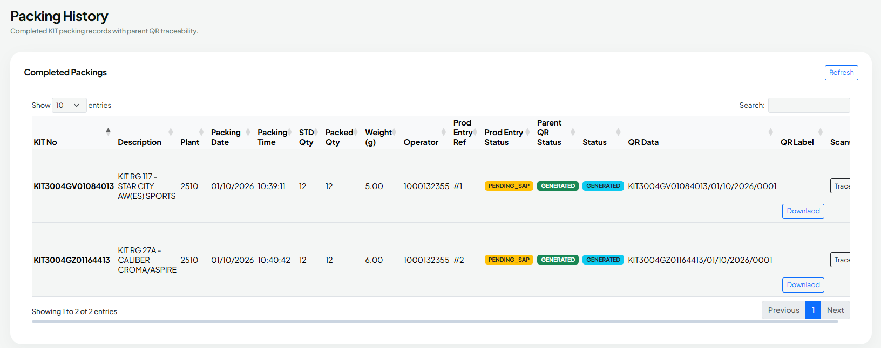
KIT PACKING HISTORY REPORT
Kit Packing History Dashboard
LGB l Operations Technology

Slide 19
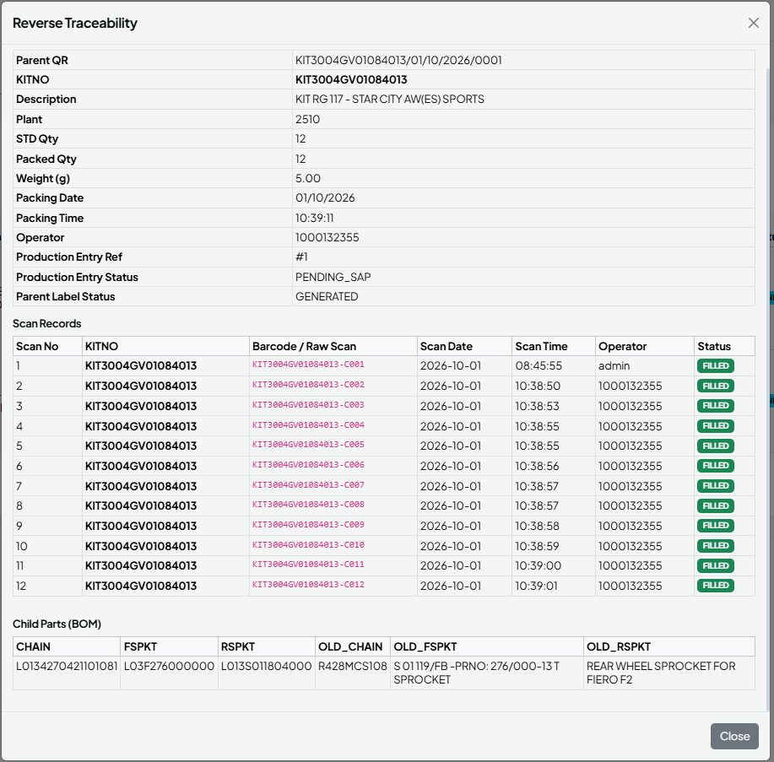
KIT PACKING REVERSE TRACEABILITY CARD
Kit Packing Reverse Traceability
Report
LGB l Operations Technology

Slide 20
06
SMD - AIRBAG STITCH PATTERN ANALYSIS – WBS / PROJECT SCHEDULE

Slide 21
AIRBAG STITCH PATTERN ANALYSIS – WBS / PROJECT SCHEDULE
Requirements → Camera Setup → Dataset → Segmentation Model → Geometry Analysis → PASS/NOT OK → Integration → Validation → Deployment
WBS ID | Task Description | Duration (Days) | Planned Start | Planned Finish | Actual Start | Actual Finish | Remarks / Deliverable | Status | % Completion | Weightage | Weighted Score
1.00 | PROJECT INITIATION & REQUIREMENTS
1.01 | Review airbag stitch inspection requirements and current documentation |  | 03/Sep/26 | 03/Sep/26 | 03/Sep/26 | 04/Sep/26 | Define inspection scope, target patterns and production constraints | completed | 100% | 3 | 3.0
1.02 | Confirm stitch classes and defect cases |  | 07/Sep/26 | 14/Sep/26 | 09/Sep/26 |  | Inner circle, outer circle, straight,notch,curved line, incorrect pattern/position | InProgress | 70% | 3 | 2.1
1.03 | Define measurement tolerances and acceptance rules |  | 12/Oct/26 | 12/Oct/26 |  |  | Confirm diameter, position, geometry, continuity and image-quality criteria | Not Started | 0% | 4 | 0.0
1.04 | Finalize hardware, camera, lighting and runtime configuration |  | 21/Sep/26 | 14/Oct/26 | 23/Sep/26 |  | Raspberry Pi 4 Test | InProgress | 50% | 3 | 1.5
2.00 | CAMERA, LIGHTING & IMAGE ACQUISITION
2.01 | Install and configure camera |  | 14/Sep/26 |  |  |  | Fixed camera position, focus, exposure and field of view | Not Started | 0% | 4 | 0.0
2.02 | Implement camera initialization and image capture |  | 17/Sep/26 | 17/Sep/26 | 17/Sep/26 | 17/Sep/26 | Capture inspection image for each inspection cycle | completed | 100% | 4 | 4.0
2.03 | Implement image-quality validation |  | 31-09-26 |  |  |  | Check image availability, brightness, blur/focus and ROI visibility | Not Started | 0% | 4 | 0.0
2.04 | Define and validate stitch ROI extraction |  | 17/Sep/26 | 17/Sep/26 | 17/Sep/26 | 17/Sep/26 | Crop relevant airbag/stitch inspection region | completed | 100% | 3 | 3.0
3.00 | DATASET PREPARATION & ANNOTATION
3.01 | Collect representative airbag stitch images |  | 15/Sep/26 | 15/Sep/26 | 16/Sep/26 | 16/Sep/26 | Include target patterns, backgrounds and production variations | Not Started | 0% | 4 | 0.0
3.02 | Prepare positive and negative/defect examples |  | 10/Oct/26 | 10/Oct/26 | 10/Oct/26 |  | Missing stitch, wrong pattern/position and image-quality failures | InProgress | 0% | 4 | 0.0
3.03 | Annotate stitch regions with segmentation masks/polygons |  | 21/Sep/26 | 24/Sep/26 | 21/Sep/26 |  | Use agreed class names and consistent annotation rules | InProgress | 60% | 5 | 3.0
3.04 | Review labels and remove duplicate/poor-quality images |  | 19/Sep/26 | 19/Sep/26 | 19/Sep/26 | 19/Sep/26 | Quality-check annotations and dataset coverage | completed | 100% | 3 | 3.0
3.05 | Split dataset into training, validation and test sets |  | 21/Sep/26 | 22/Sep/26 | 21/Sep/26 | 22/Sep/26 | Record dataset version and class distribution | completed | 100% | 3 | 3.0
4.00 | AI SEGMENTATION MODEL DEVELOPMENT
4.01 | Configure training and augmentation |  | 18/Sep/26 | 23/Sep/26 | 19/Sep/26 |  | Use suitable rotation, scale, brightness and perspective variation where appropriate | InProgress | 60% | 4 | 2.4
4.02 | Train stitch segmentation model |  | 11/Sep/26 | 18/Sep/26 | 13/Sep/26 | 18/Sep/26 | Train using reviewed segmentation dataset | completed | 100% | 5 | 5.0
4.03 | Evaluate model and inspect false positives/false negatives |  |  |  |  |  | Review class-wise results and segmentation masks | Not Started | 0% | 4 | 0.0
4.04 | Tune confidence/IoU settings and export deployment model |  | 12/Oct/26 | 12/Oct/26 |  |  | Record model version and deployment artifact | Not Started | 0% | 3 | 0.0
4.05 | Validate inference on target hardware |  | 15/Sep/26 | 30/Sep/26 | 13/Sep/26 |  | Measure inference time on Raspberry Pi 4 | InProgress | 70% | 4 | 2.8
5.00 | OPENCV GEOMETRY & DECISION LOGIC
5.02 | Implement circle detection |  | 16/Sep/26 | 18/Sep/26 | 16/Sep/26 | 19/Sep/26 | Measure inner/outer circular stitch | completed | 100% | 5 | 5.0
5.04 | Implement straight and curved stitch geometry checks |  | 01/Oct/26 | 10/Oct/26 | 09/Oct/26 |  | Evaluate shape and expected pattern | InProgress | 40% | 4 | 1.6
5.05 | Implement stitch continuity and missing/broken checks |  | 12/Oct/26 | 15/Oct/26 |  |  | Detect interruptions and missing regions | Not Started | 0% | 5 | 0.0
5.06 | Implement tolerance-based PASS / NOT OK decision |  | 23/Sep/26 | 12/Oct/26 |  |  | Combine image quality, geometry, position and continuity checks | InProgress | 50% | 4 | 2.0

Slide 22
AIRBAG STITCH PATTERN ANALYSIS – WBS / PROJECT SCHEDULE
Requirements → Camera Setup → Dataset → Segmentation Model → Geometry Analysis → PASS/NOT OK → Integration → Validation → Deployment
WBS ID | Task Description | Duration (Days) | Planned Start | Planned Finish | Actual Start | Actual Finish | Remarks / Deliverable | Status | % Completion | Weightage | Weighted Score
6.00 | APPLICATION, DATABASE & IMAGE STORAGE
6.01 | Build inspection workflow and result flow |  | 05/Oct/26 | 06/Oct/26 |  |  | Capture → validate → ROI → segmentation → analysis → decision | InProgress | 50% | 4 | 2.0
6.02 | Create PostgreSQL inspection result schema |  | 12/Oct/26 | 12/Oct/26 |  |  | Inspection ID, timestamp, part/serial, pattern, confidence, checks, result, defect reason, image path, model version | Not Started | 0%
6.03 | UI Design For SMD |  | 07/Oct/26 | 16/Oct/26 | 07/Oct/26 |  | Develop a dashboard for stitch and part validation, store OK and NOT OK inspection reports, customize application settings, and automatically transfer data when storage reaches 80%. | InProgress | 50% | 4 | 2.0
6.03 | Store inspection images, results and application logs |  | 13/Oct/26 | 13/Oct/26 |  |  | Organize by date and retain traceability | Not Started | 0% | 3 | 0.0
6.04 | Implement error handling and system logging |  | 13/Oct/26 | 13/Oct/26 |  |  | Camera, model, database, image-quality and storage errors | Not Started | 0% | 3 | 0.0
7.00 | STORAGE MANAGEMENT & NETWORK TRANSFER
7.01 | Implement continuous local-storage monitoring |  | 15/Oct/26 | 15/Oct/26 |  |  | Check local disk utilization | Not Started | 0% | 3 | 0.0
7.02 | Trigger transfer when storage reaches 80% |  | 15/Oct/26 | 15/Oct/26 |  |  | Transfer older inspection data to configured PC/server | Not Started | 0% | 4 | 0.0
7.03 | Implement retry and network-failure handling |  | 15/Oct/26 | 15/Oct/26 |  |  | Keep untransferred data locally and retry automatically | Not Started | 0% | 4 | 0.0
7.04 | Verify transferred files before local deletion |  | 15/Oct/26 | 15/Oct/26 |  |  | Delete only after successful verification; prevent duplicate transfer | Not Started | 0% | 4 | 0.0
7.05 | Implement storage warning and critical alarm thresholds |  | 15/Oct/26 | 16/Oct/26 |  |  | 80% transfer; 90% warning and 95% critical as configurable recommendations | Not Started | 0% | 2 | 0.0
8.00 | TESTING, VALIDATION & ACCEPTANCE
8.01 | Test each required stitch pattern |  | 15/Sep/26 | 13/Oct/26 | 18/Sep/26 |  | Inner circle, outer circle, straight and curved double stitch | InProgress | 50% | 4 | 2.0
8.02 | Test missing, wrong pattern/position |  | 20/Sep/26 | 14/Oct/26 |  |  | Expected NOT OK result | Not Started | 0% | 4 | 0.0
8.03 | Test geometry, diameter, position and continuity tolerances |  | 10/Oct/26 | 13/Oct/26 |  |  | Valid part PASS; out-of-tolerance part NOT OK | Not Started | 0% | 5 | 0.0
8.04 | Test blur, low light, camera/model/database failures |  | 10/Oct/26 | 13/Oct/26 |  |  | Expected image-quality/system error handling | Not Started | 0% | 4 | 0.0
8.05 | Test storage threshold, network outage and recovery |  | 13/Oct/26 | 15/Oct/26 |  |  | Retain data locally, retry, verify transfer | Not Started | 0% | 4 | 0.0
9.00 | DEPLOYMENT, DOCUMENTATION & HANDOVER
9.01 | Deploy application and model to target Ubuntu |  | 22/Oct/26 | 22/Oct/26 |  |  | Configure camera, model, database and storage destination | Not Started | 0% | 3 | 0.0
9.02 | Handover source code, model, configuration and test evidence |  | 22/Oct/26 | 23/Oct/26 |  |  | Release package and maintenance notes | Not Started | 0% | 2 | 0.0

Slide 23
07
Complete List of Digitalization Projects 2026

Slide 24
S.No | WBS ID | Plant | Line | Task / Project | WBS Activity | Planned Start | Planned End | Actual Start | Actual End | Status | Responsibility | Dependency / Reason | Remarks
1 | 1 | K.Palayam | RAD | BMW Digitalization | PRISM & Operator Buddy Implementation – Machine Interlock | 01/10/2026 | 09/10/2026 |  |  | In Progress | Plant IT | Interlock completed for 7 machines; remaining 4 machines pending due to Ethernet connectivity issues.
 | 1.1 |  |  |  | Requirement confirmation | 02/10/2026 | 03/10/2026
 | 1.2 |  |  |  | Machine/PLC signal identification | 03/10/2026 | 04/10/2026
 | 1.3 |  |  |  | Plant-side wiring & network readiness | 04/10/2026 | 05/10/2026
 | 1.4 |  |  |  | Interlock logic implementation | 05/10/2026 | 06/10/2026
 | 1.5 |  |  |  | PRISM/Operator Buddy integration | 06/10/2026 | 07/10/2026
 | 1.6 |  |  |  | Machine-wise testing | 07/10/2026 | 08/10/2026
 | 1.7 |  |  |  | Deployment & handover | 08/10/2026 | 09/10/2026
2 | 2 | K.Palayam | RAD | BMW Digitalization | Data Collection from Machine | 12/10/2026 | 22/10/2026 |  |  | Pending | Plant IT | 6 machines completed. KM-TU-13 pending because the IP address is not responding to ping from the DB PC.
 | 2.1 |  |  |  | Requirement confirmation | 13/10/2026 | 16/10/2026
 | 2.2 |  |  |  | Machine/network readiness | 14/10/2026 | 17/10/2026
 | 2.3 |  |  |  | Signal/tag verification | 15/10/2026 | 18/10/2026
 | 2.4 |  |  |  | Edge device setup | 16/10/2026 | 19/10/2026
 | 2.5 |  |  |  | Data logging script preparation | 17/10/2026 | 20/10/2026
 | 2.6 |  |  |  | Testing & deployment | 18/10/2026 | 21/10/2026
 | 2.7 |  |  |  | Data validation & handover | 19/10/2026 | 22/10/2026
3 | 3 | K.Palayam | BOSCH | Bosch Digitalization | Data Collection from Machine | 09/10/2026 | 17/10/2026 |  |  | Partially Completed | Gowtham | 13 machines completed; 1 machine pending due to relay wiring by maintenance.
 | 3.1 |  |  |  | Requirement confirmation | 10/10/2026 | 11/10/2026
 | 3.2 |  |  |  | Machine/network readiness | 11/10/2026 | 12/10/2026
 | 3.3 |  |  |  | Signal/tag verification | 12/10/2026 | 13/10/2026
 | 3.4 |  |  |  | Edge device setup | 13/10/2026 | 14/10/2026
 | 3.5 |  |  |  | Data logging script preparation | 14/10/2026 | 15/10/2026
 | 3.6 |  |  |  | Testing & deployment | 15/10/2026 | 16/10/2026
 | 3.7 |  |  |  | Data validation & handover | 16/10/2026 | 17/10/2026

Slide 25
S.No | WBS ID | Plant | Line | Task / Project | WBS Activity | Planned Start | Planned End | Actual Start | Actual End | Status | Responsibility | Dependency / Reason | Remarks
4 | 4 | K.Palayam | BMW | BMW Digitalization | Grinding Machine Datalogging | 09/10/2026 | 16/10/2026 |  |  | Pending | MBD | Datalogging is pending due to MBD assistance.
 | 4.1 |  |  |  | Requirement confirmation | 10/10/2026 | 10/10/2026
 | 4.2 |  |  |  | MBD communication | 11/10/2026 | 11/10/2026
 | 4.3 |  |  |  | OPC/PLC/tag verification | 12/10/2026 | 12/10/2026
 | 4.4 |  |  |  | Edge communication setup | 13/10/2026 | 13/10/2026
 | 4.5 |  |  |  | Datalogging script preparation | 14/10/2026 | 14/10/2026
 | 4.6 |  |  |  | Testing | 15/10/2026 | 15/10/2026
 | 4.7 |  |  |  | Deployment & validation | 16/10/2026 | 16/10/2026
5 | 5 | K.Palayam | BOSCH | Bosch Digitalization | Data Collection from Machine | 10/10/2026 | 17/10/2026 |  |  | Pending | Gowtham | IP addresses are mapped; data logging needs to be completed for 8 machines using MT-Link.
 | 5.1 |  |  |  | Requirement confirmation | 11/10/2026 | 11/10/2026
 | 5.2 |  |  |  | Machine/network readiness | 12/10/2026 | 12/10/2026
 | 5.3 |  |  |  | Signal/tag verification | 13/10/2026 | 13/10/2026
 | 5.4 |  |  |  | Edge device setup | 14/10/2026 | 14/10/2026
 | 5.5 |  |  |  | Data logging script preparation | 15/10/2026 | 15/10/2026
 | 5.6 |  |  |  | Testing & deployment | 16/10/2026 | 16/10/2026
 | 5.7 |  |  |  | Data validation & handover | 17/10/2026 | 17/10/2026
6 | 6 | Annur | CMBF | Furnace Dashboard | Data Logging from Furnace | 14/10/2026 | 22/10/2026 |  |  | Partially Completed | Gowtham | 1 furnace completed and data integrated into PRISM; remaining 1 furnace pending due to Ethernet connectivity.
 | 6.1 |  |  |  | Requirement confirmation | 15/10/2026 | 16/10/2026
 | 6.2 |  |  |  | Network/IP readiness | 16/10/2026 | 17/10/2026
 | 6.3 |  |  |  | Signal/tag verification | 17/10/2026 | 18/10/2026
 | 6.4 |  |  |  | Edge device communication | 18/10/2026 | 19/10/2026
 | 6.5 |  |  |  | Data logging script preparation | 19/10/2026 | 20/10/2026
 | 6.6 |  |  |  | Testing & deployment | 20/10/2026 | 21/10/2026
 | 6.7 |  |  |  | PRISM/dashboard integration & validation | 21/10/2026 | 22/10/2026
7 | 7 | Annur | Rotary Furnace | Furnace Dashboard | Data Logging from Furnace | 19/10/2026 | 06/11/2026 |  |  | Pending | MBD | Data logging for 14 furnaces is pending due to MBD assistance.
 | 7.1 |  |  |  | Requirement confirmation | 20/10/2026 | 31/10/2026
 | 7.2 |  |  |  | Network/IP readiness | 21/10/2026 | 01/11/2026
 | 7.3 |  |  |  | Signal/tag verification | 22/10/2026 | 02/11/2026
 | 7.4 |  |  |  | Edge device communication | 23/10/2026 | 03/11/2026
 | 7.5 |  |  |  | Data logging script preparation | 24/10/2026 | 04/11/2026
 | 7.6 |  |  |  | Testing & deployment | 25/10/2026 | 05/11/2026
 | 7.7 |  |  |  | PRISM/dashboard integration & validation | 26/10/2026 | 06/11/2026

Slide 26
S.No | WBS ID | Plant | Line | Task / Project | WBS Activity | Planned Start | Planned End | Actual Start | Actual End | Status | Responsibility | Dependency / Reason | Remarks
8 | 8 | PGR | SQF | Furnace Dashboard | Energy Meter Data Collection from Furnace | 05/10/2026 | 03/11/2026 |  |  | Pending | Plant Electrical | RS-485 converter device purchase from plant side is pending.
 | 8.1 |  |  |  | Requirement confirmation | 06/10/2026 | 28/10/2026
 | 8.2 |  |  |  | Meter/register mapping | 07/10/2026 | 29/10/2026
 | 8.3 |  |  |  | RS-485 converter procurement | 08/10/2026 | 30/10/2026
 | 8.4 |  |  |  | Modbus communication setup | 09/10/2026 | 31/10/2026
 | 8.5 |  |  |  | Data logging script preparation | 10/10/2026 | 01/11/2026
 | 8.6 |  |  |  | Testing & validation | 11/10/2026 | 02/11/2026
 | 8.7 |  |  |  | Dashboard integration | 12/10/2026 | 03/11/2026
9 | 9 | PGR | SQF | Furnace Dashboard | Furnace Charge-IN and Charge-OUT Data Collection | 05/11/2026 | 19/11/2026 |  |  | Pending | Plant Electrical | Data collection is pending due to wiring requirement from plant side.
 | 9.1 |  |  |  | Requirement confirmation | 06/11/2026 | 13/11/2026
 | 9.2 |  |  |  | Charge-IN/OUT signal identification | 07/11/2026 | 14/11/2026
 | 9.3 |  |  |  | Plant-side wiring | 08/11/2026 | 15/11/2026
 | 9.4 |  |  |  | Edge device input testing | 09/11/2026 | 16/11/2026
 | 9.5 |  |  |  | Data logging script | 10/11/2026 | 17/11/2026
 | 9.6 |  |  |  | Testing & validation | 11/11/2026 | 18/11/2026
 | 9.7 |  |  |  | PRISM/dashboard integration | 12/11/2026 | 19/11/2026
10 | 10 | PGR | CNC | CNC Digitalization | Data Collection from Machine | 06/10/2026 | 14/10/2026 |  |  | Pending | Gowtham | R&D support from OT side is required.
 | 10.1 |  |  |  | Requirement confirmation | 07/10/2026 | 08/10/2026
 | 10.2 |  |  |  | OT/R&D communication | 08/10/2026 | 09/10/2026
 | 10.3 |  |  |  | Machine communication/tag verification | 09/10/2026 | 10/10/2026
 | 10.4 |  |  |  | Edge device setup | 10/10/2026 | 11/10/2026
 | 10.5 |  |  |  | Data logging script preparation | 11/10/2026 | 12/10/2026
 | 10.6 |  |  |  | Testing & deployment | 12/10/2026 | 13/10/2026
 | 10.7 |  |  |  | Data validation & handover | 13/10/2026 | 14/10/2026
11 | 11 | P.Palayam | SQF | Furnace Dashboard | Data Collection from Furnace | 07/10/2026 | 14/10/2026 |  |  | Pending | Gowtham | Data collection is pending due to vendor assistance for IP change.
 | 11.1 |  |  |  | Requirement confirmation | 08/10/2026 | 08/10/2026
 | 11.2 |  |  |  | Network/IP readiness | 09/10/2026 | 09/10/2026
 | 11.3 |  |  |  | Signal/tag verification | 10/10/2026 | 10/10/2026
 | 11.4 |  |  |  | Edge device communication | 11/10/2026 | 11/10/2026
 | 11.5 |  |  |  | Data logging script preparation | 12/10/2026 | 12/10/2026
 | 11.6 |  |  |  | Testing & deployment | 13/10/2026 | 13/10/2026
 | 11.7 |  |  |  | PRISM/dashboard integration & validation | 14/10/2026 | 14/10/2026

Slide 27
S.No | WBS ID | Plant | Line | Task / Project | WBS Activity | Planned Start | Planned End | Actual Start | Actual End | Status | Responsibility | Dependency / Reason | Remarks
12 | 12 | P.Palayam | Chain | Press Dashboard | Data Collection from Stamping Press | 01/11/2026 | 08/11/2026 |  |  | Pending | Gowtham | R&D support from OT side is required.
 | 12.1 |  |  |  | Requirement confirmation | 02/11/2026 | 02/11/2026
 | 12.2 |  |  |  | Machine signal identification | 03/11/2026 | 03/11/2026
 | 12.3 |  |  |  | Plant-side wiring/network readiness | 04/11/2026 | 04/11/2026
 | 12.4 |  |  |  | Edge device setup | 05/11/2026 | 05/11/2026
 | 12.5 |  |  |  | Stroke/data logging script | 06/11/2026 | 06/11/2026
 | 12.6 |  |  |  | Testing & validation | 07/11/2026 | 07/11/2026
 | 12.7 |  |  |  | Dashboard integration | 08/11/2026 | 08/11/2026
13 | 13 | P.Palayam | Daimler | Daimler Line Digitalization | Data Collection from Machines and Display in PRISM | 05/10/2026 | 13/10/2026 |  |  | In Progress | Plant IT | Data collection from machines is pending due to Ethernet connectivity.
 | 13.1 |  |  |  | Requirement confirmation | 06/10/2026 | 07/10/2026
 | 13.2 |  |  |  | Machine/network readiness | 07/10/2026 | 08/10/2026
 | 13.3 |  |  |  | Signal/tag verification | 08/10/2026 | 09/10/2026
 | 13.4 |  |  |  | Edge device setup | 09/10/2026 | 10/10/2026
 | 13.5 |  |  |  | Data logging script preparation | 10/10/2026 | 11/10/2026
 | 13.6 |  |  |  | Testing & deployment | 11/10/2026 | 12/10/2026
 | 13.7 |  |  |  | Data validation & handover | 12/10/2026 | 13/10/2026
14 | 14 | P.Palayam | Daimler | Daimler Line Automation | Data Collection from COBOT PLC using Tags and Display in PRISM | 05/10/2026 | 13/10/2026 |  |  | In Progress | Plant IT | Waiting for Ethernet connectivity and switch installation.
 | 14.1 |  |  |  | Requirement confirmation | 06/10/2026 | 07/10/2026
 | 14.2 |  |  |  | COBOT PLC tag mapping | 07/10/2026 | 08/10/2026
 | 14.3 |  |  |  | Ethernet/switch readiness | 08/10/2026 | 09/10/2026
 | 14.4 |  |  |  | OPC/PLC communication testing | 09/10/2026 | 10/10/2026
 | 14.5 |  |  |  | Data logging script | 10/10/2026 | 11/10/2026
 | 14.6 |  |  |  | PRISM integration | 11/10/2026 | 12/10/2026
 | 14.7 |  |  |  | Testing & handover | 12/10/2026 | 13/10/2026
15 | 15 | P.Palayam | Stellantis | Stellantis Line Digitalization | Push Data from SQLite to MongoDB | 12/10/2026 | 20/10/2026 |  |  | Pending | Gowtham | Development/start activity planned; MongoDB data push implementation to be completed.
 | 15.1 |  |  |  | Requirement confirmation | 13/10/2026 | 14/10/2026
 | 15.2 |  |  |  | SQLite data validation | 14/10/2026 | 15/10/2026
 | 15.3 |  |  |  | MongoDB connection/configuration | 15/10/2026 | 16/10/2026
 | 15.4 |  |  |  | Data push script development | 16/10/2026 | 17/10/2026
 | 15.5 |  |  |  | Error handling & logging | 17/10/2026 | 18/10/2026
 | 15.6 |  |  |  | Testing | 18/10/2026 | 19/10/2026
 | 15.7 |  |  |  | Deployment & validation | 19/10/2026 | 20/10/2026

Slide 28
S.No | WBS ID | Plant | Line | Task / Project | WBS Activity | Planned Start | Planned End | Actual Start | Actual End | Status | Responsibility | Dependency / Reason | Remarks
16 | 16 | Valiyampalayam | SQF | Furnace Dashboard | Data Collection from Furnace | 27/10/2026 | 06/11/2026 |  |  | Pending | Gowtham | Data collection is pending due to Ethernet connectivity.
 | 16.1 |  |  |  | Requirement confirmation | 28/10/2026 | 31/10/2026
 | 16.2 |  |  |  | Network/IP readiness | 29/10/2026 | 01/11/2026
 | 16.3 |  |  |  | Signal/tag verification | 30/10/2026 | 02/11/2026
 | 16.4 |  |  |  | Edge device communication | 31/10/2026 | 03/11/2026
 | 16.5 |  |  |  | Data logging script preparation | 01/11/2026 | 04/11/2026
 | 16.6 |  |  |  | Testing & deployment | 02/11/2026 | 05/11/2026
 | 16.7 |  |  |  | PRISM/dashboard integration & validation | 03/11/2026 | 06/11/2026
17 | 17 | Nagpur | Sprocket | CNC Digitalization | Data Collection from CNC Machines | 01/10/2026 | 09/10/2026 |  |  | In Progress | Plant IT | Data collection is pending due to server PC arrival.
 | 17.1 |  |  |  | Requirement confirmation | 02/10/2026 | 02/10/2026
 | 17.2 |  |  |  | OT/R&D communication | 03/10/2026 | 04/10/2026
 | 17.3 |  |  |  | Machine communication/tag verification | 04/10/2026 | 05/10/2026
 | 17.4 |  |  |  | Edge device setup | 05/10/2026 | 06/10/2026
 | 17.5 |  |  |  | Data logging script preparation | 06/10/2026 | 07/10/2026
 | 17.6 |  |  |  | Testing & deployment | 07/10/2026 | 08/10/2026
 | 17.7 |  |  |  | Data validation & handover | 08/10/2026 | 09/10/2026
18 | 18 | Nagpur | Sprocket | Press Dashboard | Data Collection from Stamping Press | 01/11/2026 | 22/11/2026 |  |  | In Progress | Plant IT | Data collection is pending due to server PC arrival.
 | 18.1 |  |  |  | Requirement confirmation | 02/11/2026 | 02/11/2026
 | 18.2 |  |  |  | Machine signal identification | 03/11/2026 | 04/11/2026
 | 18.3 |  |  |  | Plant-side wiring/network readiness | 05/11/2026 | 18/11/2026
 | 18.4 |  |  |  | Edge device setup | 06/11/2026 | 19/11/2026
 | 18.5 |  |  |  | Stroke/data logging script | 07/11/2026 | 20/11/2026
 | 18.6 |  |  |  | Testing & validation | 08/11/2026 | 21/11/2026
 | 18.7 |  |  |  | Dashboard integration | 09/11/2026 | 22/11/2026

Slide 29
Current Week KPI Summary
Projects Active: 7
Completed: 0
Under Testing: 3
Development Complete / In-Progress: 3
Kickoff Completed: 1
Overall Health: GREEN
LGB l Operations Technology

Slide 30
Next Week KPI Summary
Planned Activity | Location | Remarks | Responsibility
RFID Demo with Zebra Tech | K-Palayam | Technology Evaluation | Vishnunirmalan
LAN Laying | Jalna, Bangalore, Pantnagar, Nagpur, FPD2, LSP | Infrastructure Readiness LAN survey | Vishnunirmalan
SFQA & PRISM Integration | All Plant | Quality Data Integration need BAPI changes | Vishnunirmalan,Durga,Naveen
KG Conversion Deployment | Annur | Development & Testing | Vishnunirmalan,Maestro
Furnace Reports Enhancement | PGR | Under development | Durga
SMD - Vision Air Bag | SMD | Under development | Hariharasudhan
Kit Packing | Ganapathy | Under development | Durga
Dispatch management | PGR | No Yet Started | Durga, Vinoth
LGB l Operations Technology

Slide 31
Total Projects 2026
Oct Project progress review
LGB | Operations Technology
Thank You

